Slide 1

Lost and Found
Project Number 14
A Web-Based Portal to Help People Reunite with Their Belongings
PRESENTED BY: Group 41
Arjun Rai(IIT2023174)
Kushagra Gupta(IIT2023175)
Aniz Agarwal(IIT2023189)
Khushwant (IIT2023212)
Rohan Bingi(IIT2023209)

Slide 2
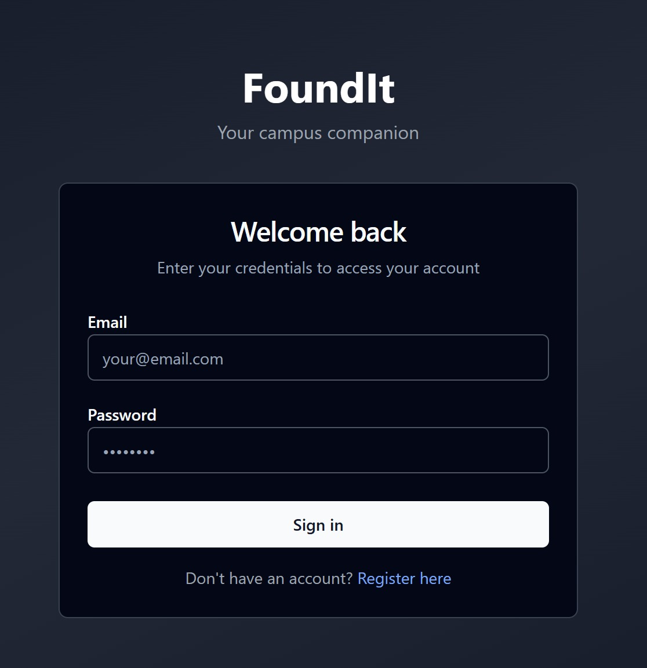
Problem Statement
Loss of Personal Items
Lack of Centralized System
People frequently lose belongings in busy public spaces.
Institutions like colleges lack unified digital recovery solutions.
Inefficient Recovery
Current methods are slow, fragmented, and opaque for users.

Slide 3
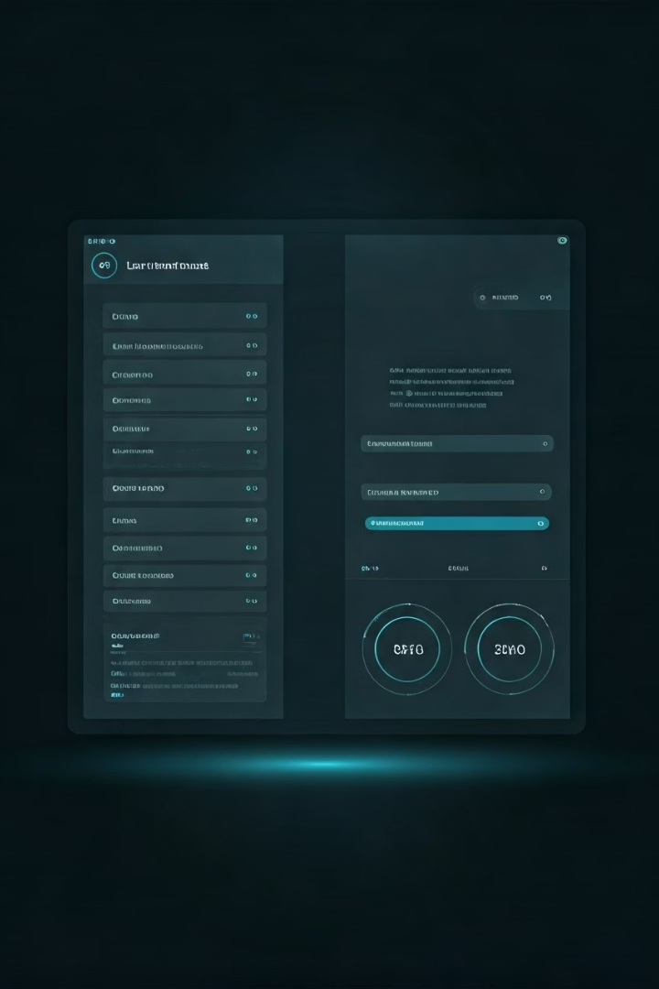
Project Objective
Simple Reporting
Search and Track
Enable easy reporting of lost or found items by users.
Allow users to quickly search and monitor item status online.
Transparent Recovery
Streamline and clarify the recovery process for everyone.

Slide 4
Technology Stack
Frontend
Backend
Database & Tools
HTML
Node.js
MySQL
CSS
Express.js
Postman (API Testing)
JavaScript
GitHub (Version Control)

Slide 5
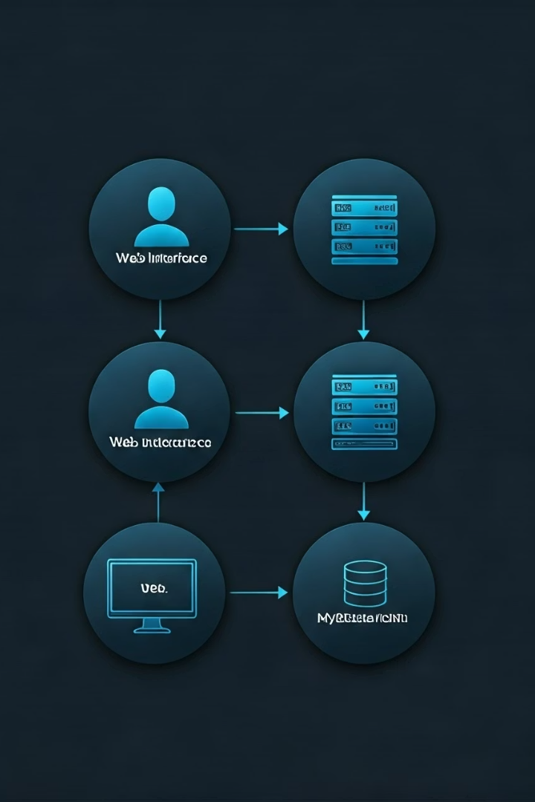




System Architecture
Users
Interact with the web UI to report or search items.
Web UI
Frontend interface sends requests to the Express server.
Express Server
Processes business logic and manages API communication.
MySQL Database
Stores and retrieves item records securely and efficiently.

Slide 6

User Interface Overview
Dashboard
Reporting Form
Search Functionality
Central place to view all lost and found items.
Simple input fields for users to submit item details quickly.
Powerful filters to find items by category, date, or location.

Slide 7

Security and Privacy
User Data Protection
Access Control
Implements encrypted communication with HTTPS and secure sessions.
Role-based permissions to safeguard sensitive information.
Data Privacy
Complies with privacy standards for transparent data usage.

Slide 8



Benefits and Impact
Institution Efficiency
2
Reduces staff workload by automating item management.
User Convenience
1
Rapid and straightforward item reporting and retrieval.
Community Trust
Builds confidence in the institution’s lost and found process.
3

Slide 9
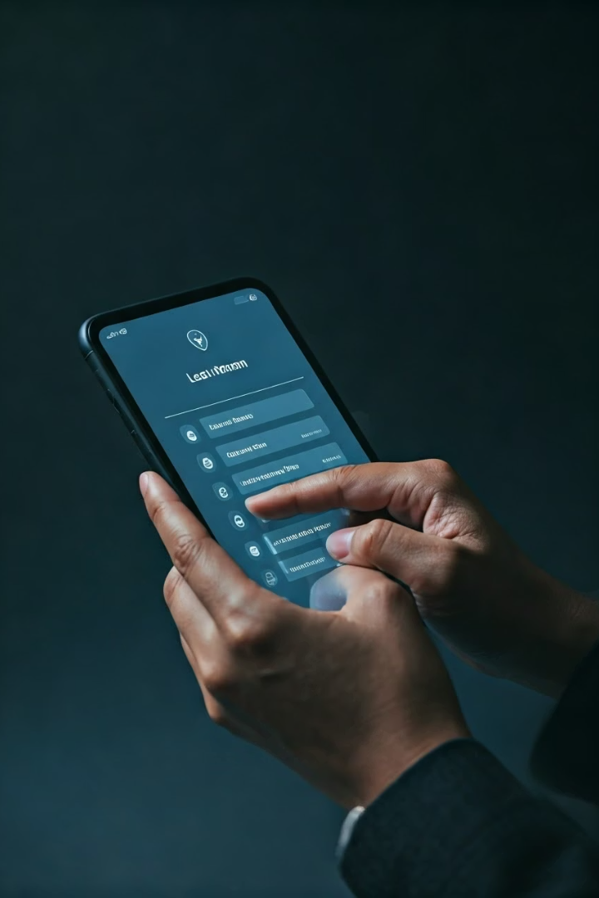
Core Features of Lost and Found
Item Reporting
Claim Verification
Report lost or found items with photo uploads and descriptions.
Secure claim attempts using custom security questions and OTP email verification.
Search & Track
Search by category or keyword and track claim/report statuses easily.
Get real time updates via mail if your lost item is found or if your item belongs to
someone else using SMTP.

Slide 10
User Interface Screenshots & Walkthrough
Reporting Form
OTP Verification Page
Search & Claim Interface
Simple, intuitive forms capture item details and photos.
Seamless and secure email confirmation with One Time Passwords.
Effortless browsing and claiming of listed items using filters and security prompts.

Slide 11
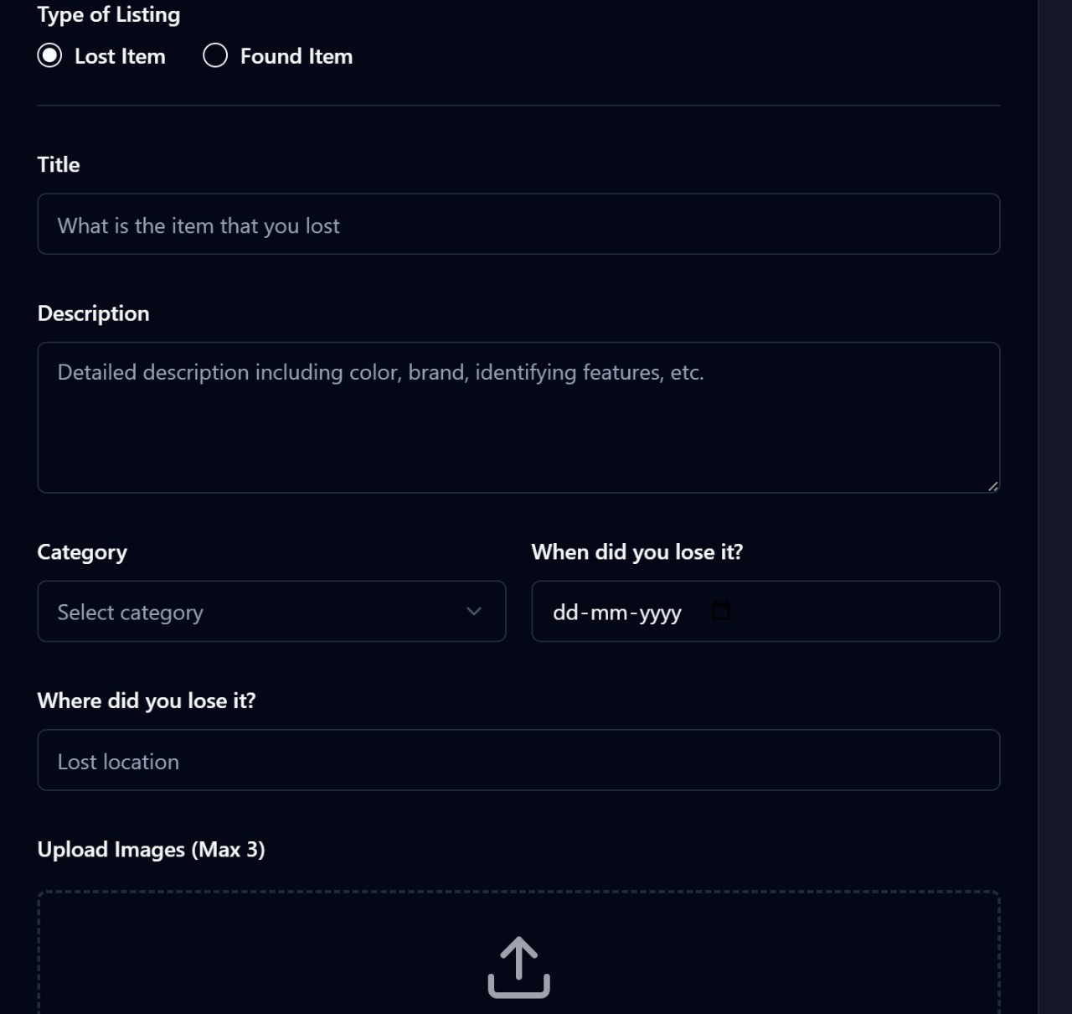
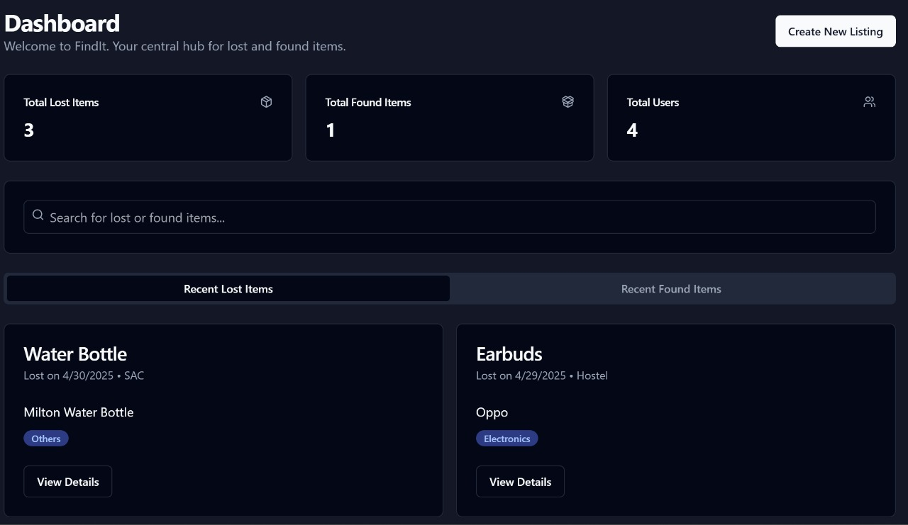

Slide 12
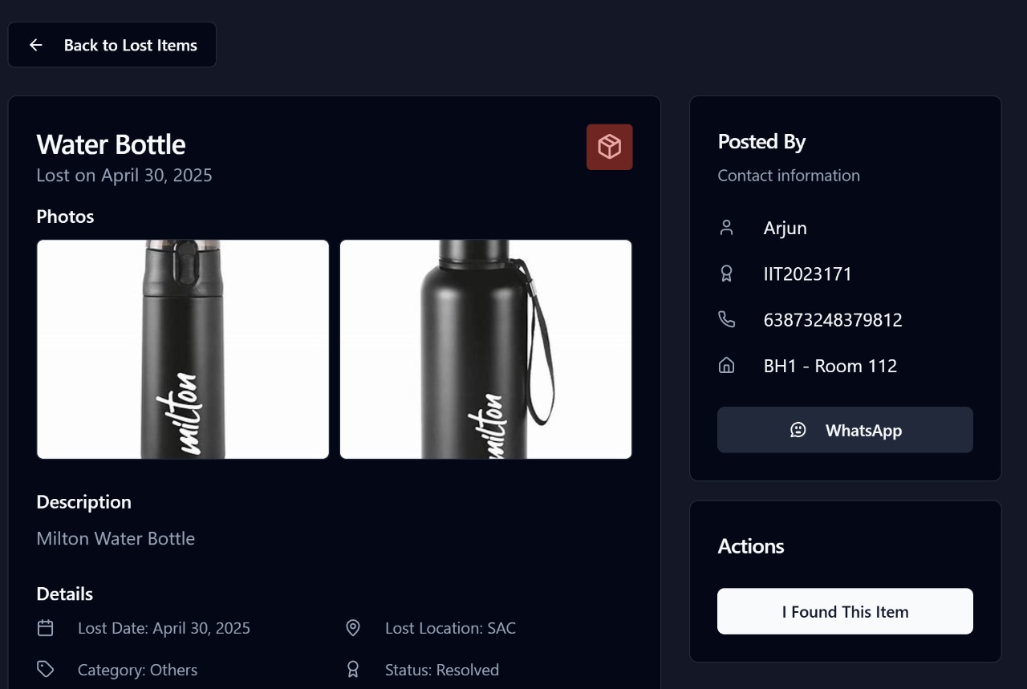

Slide 13
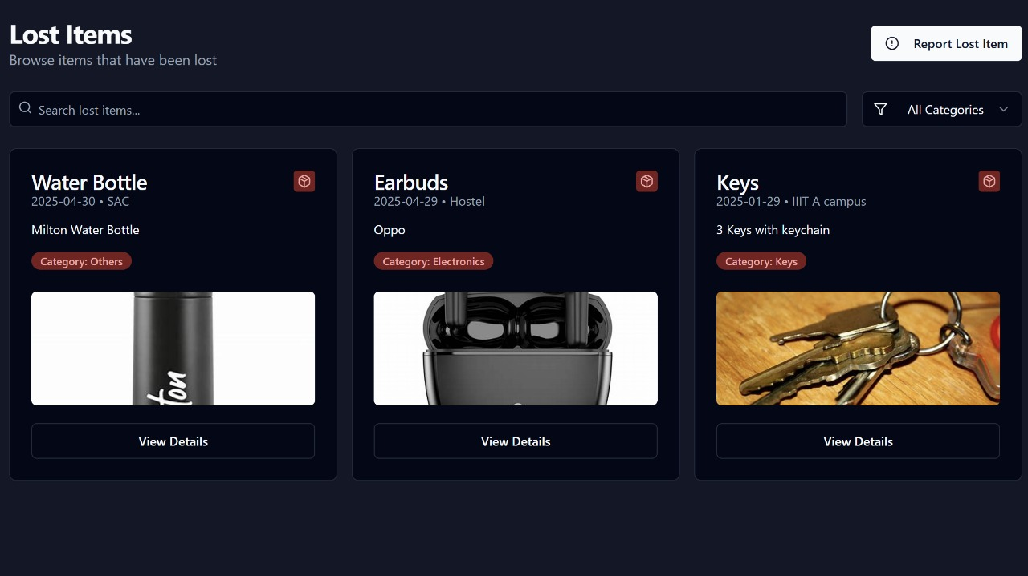

Slide 14

Challenges We Overcame
OTP Email Security
Image Uploads
Developed secure and reliable one-time password verification system.
Handled file uploads, storage, and correct linking with items.
Referential Integrity
Maintained consistent relationships among relational database tables.

Slide 15
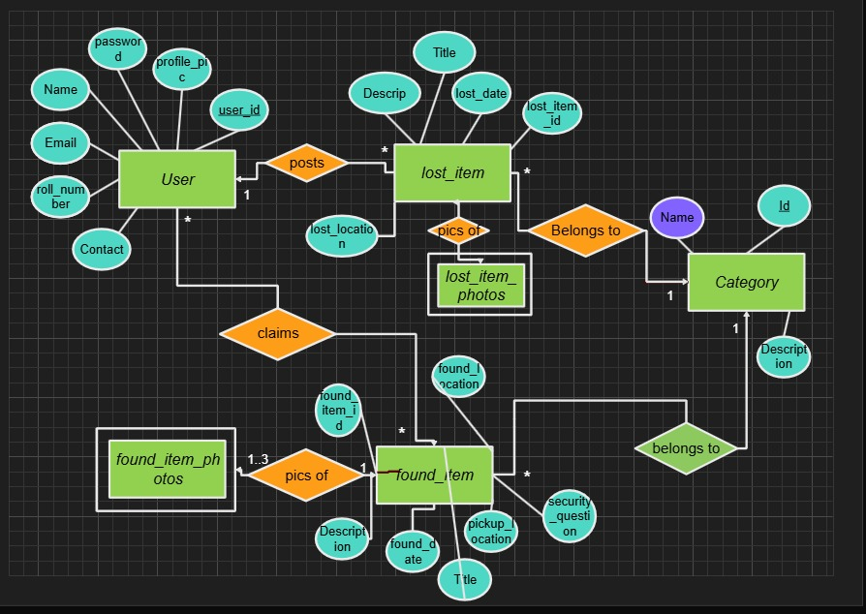

Slide 16
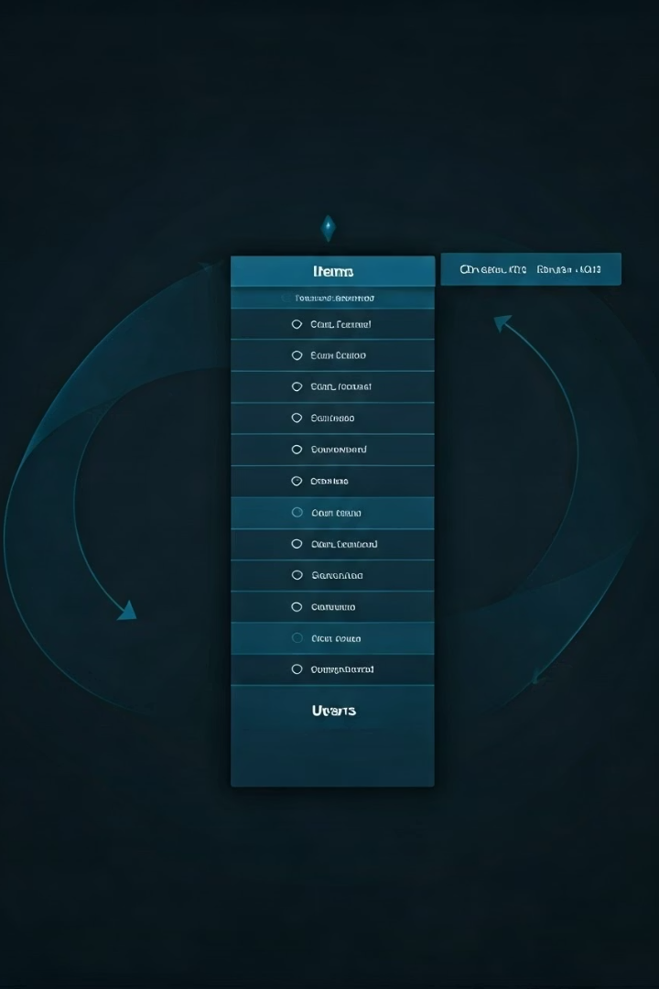
Database Design & Normalization
Tables Included
Normalization
Users, OTP verification, categories, items, photos, claims, reports
Ensures atomic values, full key dependencies, and no transitive dependencies.
Benefits
Reduces redundancy, maintains data integrity, and supports scalability.

Slide 17

Database 3NF Normalization Explained
There are no transitive dependencies betwee non-key attributes.
Non-key attributes depend only on the primary key, not on other non-key attributes.
User-related data (like phone number, hostel, room number) is stored only in the users table and referenced via foreign keys in other tables (e.g., founditems.posted_by).
Item photos are stored in separate tables (founditemphotos, lostitemphotos) and linked to their respective items via found_item_id and lost_item_id, eliminating repetition and maintaining flexibility.

Slide 18
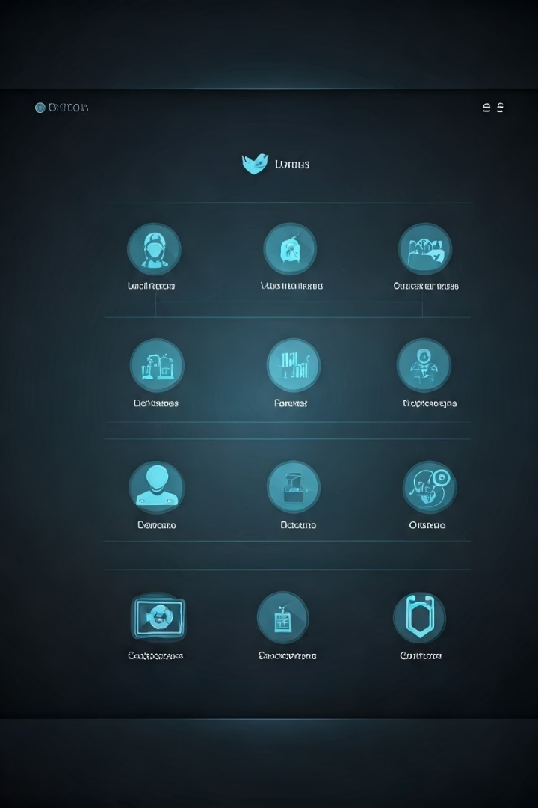
Key Entities in the System
User
Handles profiles with name, email, and location attributes.
Lost and Found Items
Separate entities storing detailed descriptions for reporting.
Category
Classifies each item under one specific type.
Photos
Multiple images per item for clear identification.

Slide 19
Relationships Between Entities
User and Items
Items and Categories
Items and Photos
Claims
Users can post many lost or found items.
Each item belongs to exactly one category.
One-to-many relation: items have multiple photos.
Users claim found items, validating with a security answer.

Slide 20
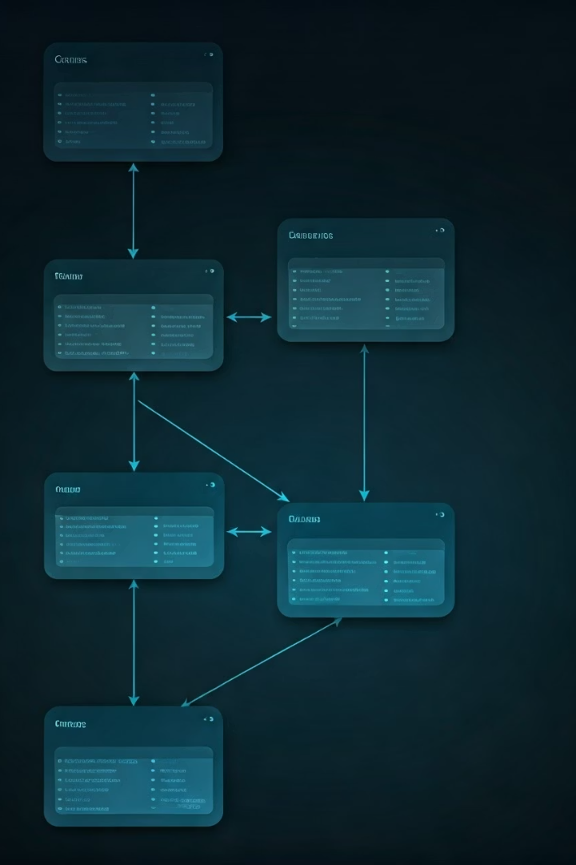
Attributes and Data Structure
Core Attributes
Composite Relationships
Name, email, location, and description assigned appropriately.
Many-to-one and many-to-many relations illustrated for key processes.
Security
Claims secured by user-provided answers for verification.

Slide 21
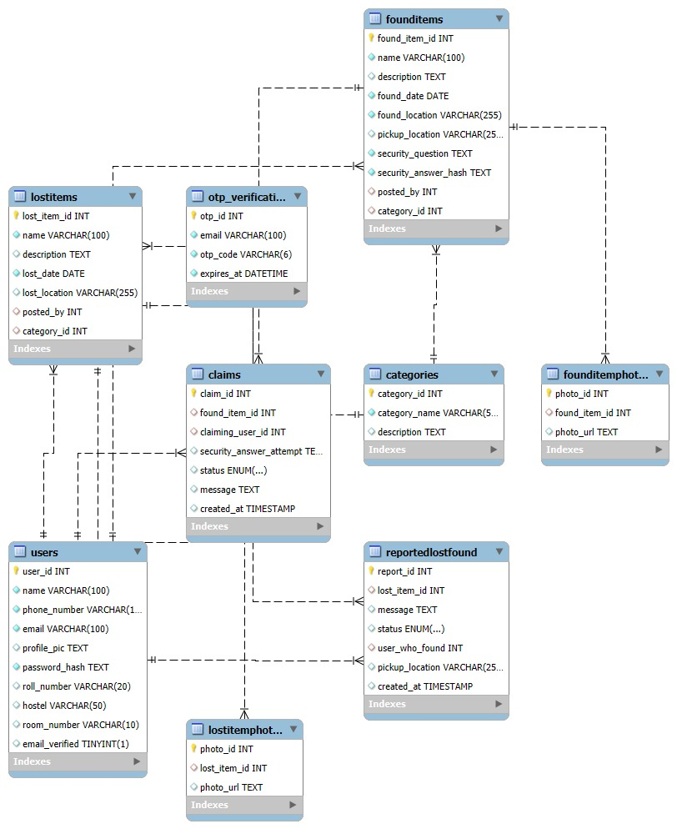

Slide 22

Normalized Tables Ensure Data Integrity
Separate Tables
Primary Keys
Each entity has its own table to prevent duplication and maintain 3NF compliance.
Unique identifiers like user_id and found_item_id ensure record uniqueness.
Foreign Keys
Links like posted_by and category_id preserve referential integrity.

Slide 23

Optimizing for Scalability and Maintenance
Photos Table
Claims Table
OTP Verification
Stores images separately to avoid redundancy and improve scalability.
Manages item claims independently to streamline record updates and queries.
Handles email security distinctly, enhancing user authentication workflows.

Slide 24




Benefits of This Schema Design
Efficient Querying
Reduces data retrieval times with well-structured relationships.
Easy Maintenance
Clear module separation simplifies updates and troubleshooting.
Data Accuracy
Prevents anomalies by enforcing normalization and key constraints.

Slide 25
THANK YOU

